Slide 1

Zeldat Team Slippee
Zeldat Extracts Loaded Data and Translates

Slide 2



The Team
Isaiah Bessire
ibessire1@ewu.edu
Devin Harrison
dharrison5@ewu.edu
Matthew Christoff
mchristoff@ewu.edu

Slide 3
Why?
Not all emulators are created equally
Most N64 emulators store save data differently
Provides seamless translation of save files between major N64 emulators.
Support translation from physical cartridge data to emulator format
Goals: Effective, Versatile, Intuitive

Slide 4
Requirements List
FR1: Bidirectional Conversion Support Conversion should be 1:1, can be done in any direction at any time
FR2: File Validation and Error Handling Invalid or corrupted files should be identified and labeled as such
NFR1: Help page for new/inexperienced users A guide for the application intended to help novice users
NFR2: Usability The GUI interface should be accessible and easy to understand, allowing inexperienced users to accomplish their goal

Slide 5
Project Solution Approach
Local application using a WebUI
Django backend
Hosted locally (e.g. localhost:64646)
Allows easy file ingestion & creation in python
Tools, frameworks, platforms
Django
htmx
Leverage browser ubiquity while allowing simple integration with python

Slide 6
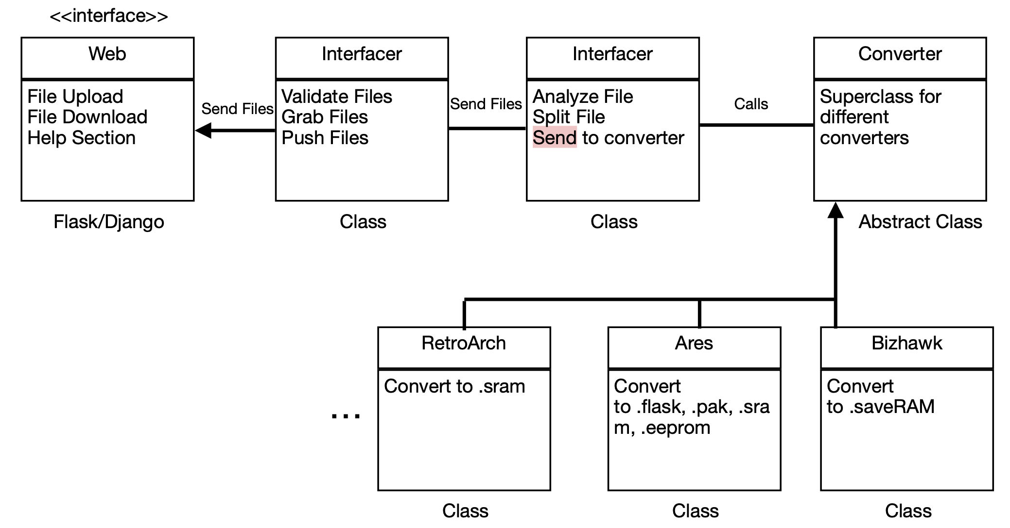
System Architecture Diagram

Slide 7
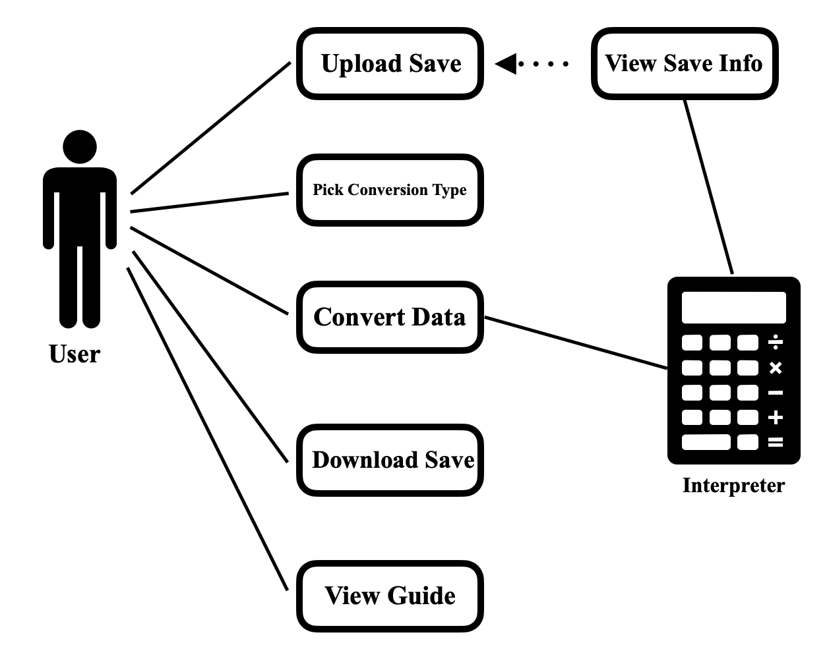
Use Case Modeling

Slide 8
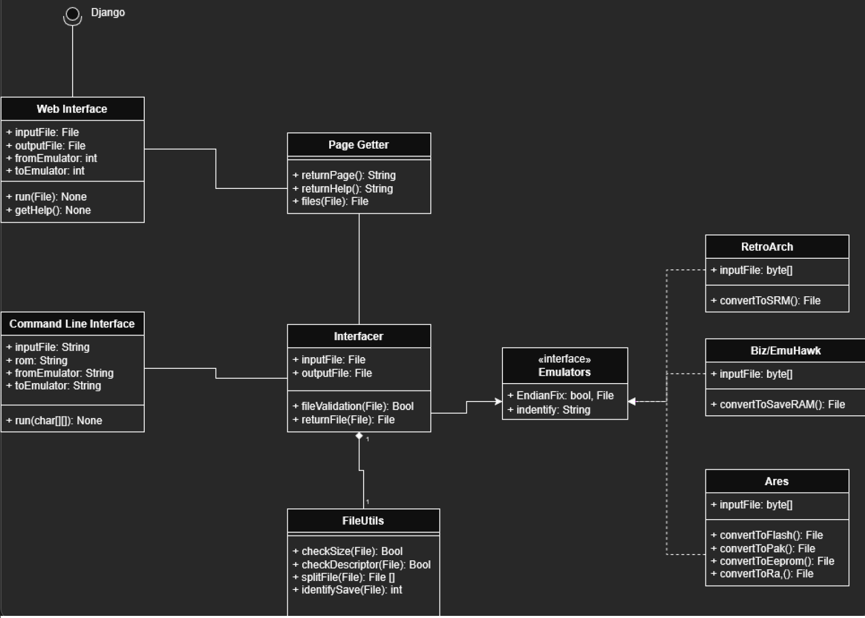
Structural Modeling: Class Diagram

Slide 9
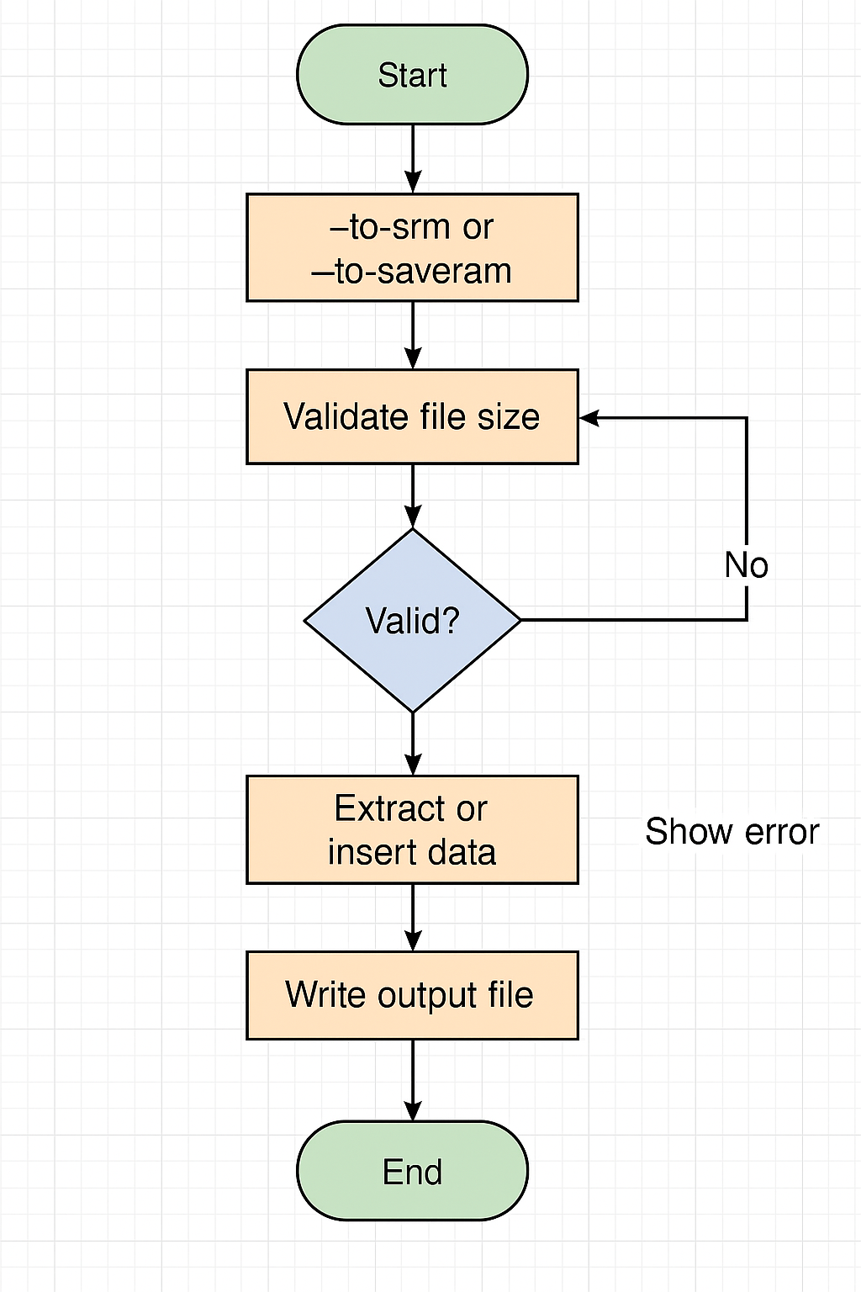
Behavioral Modeling: Sequence Diagram

Slide 10
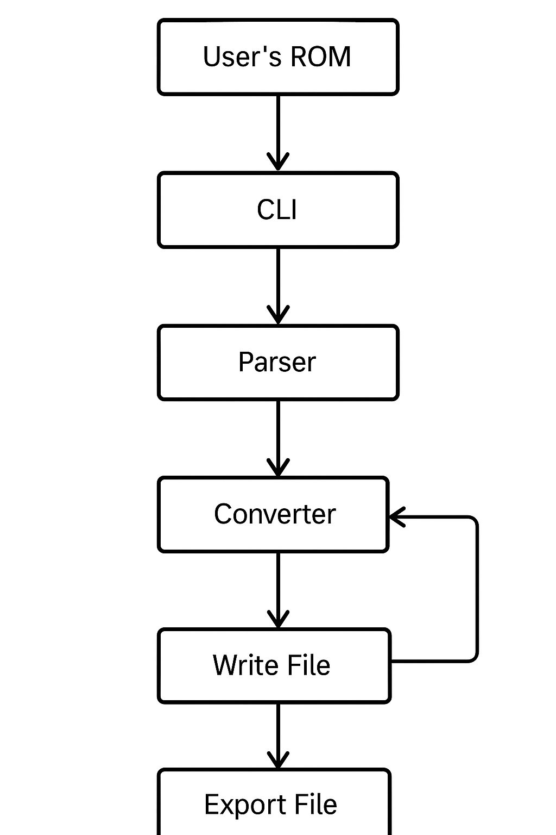
Behavioral Modeling: Activity Diagram

Slide 11
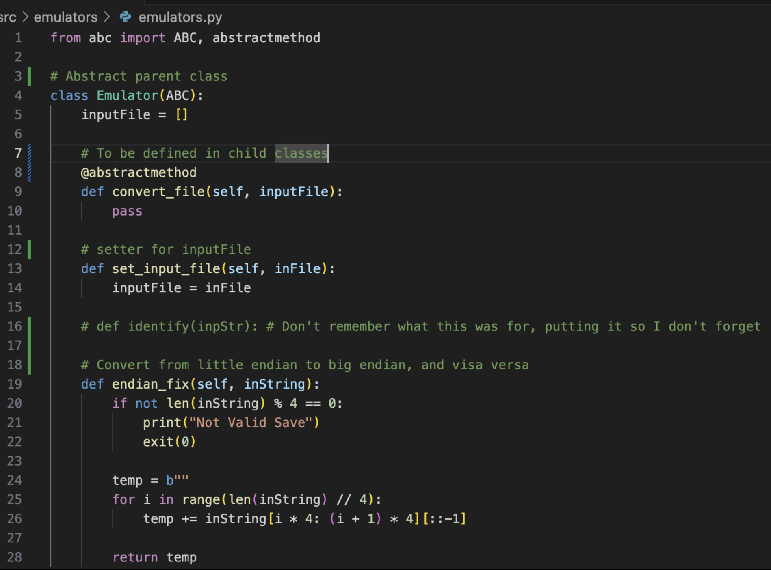
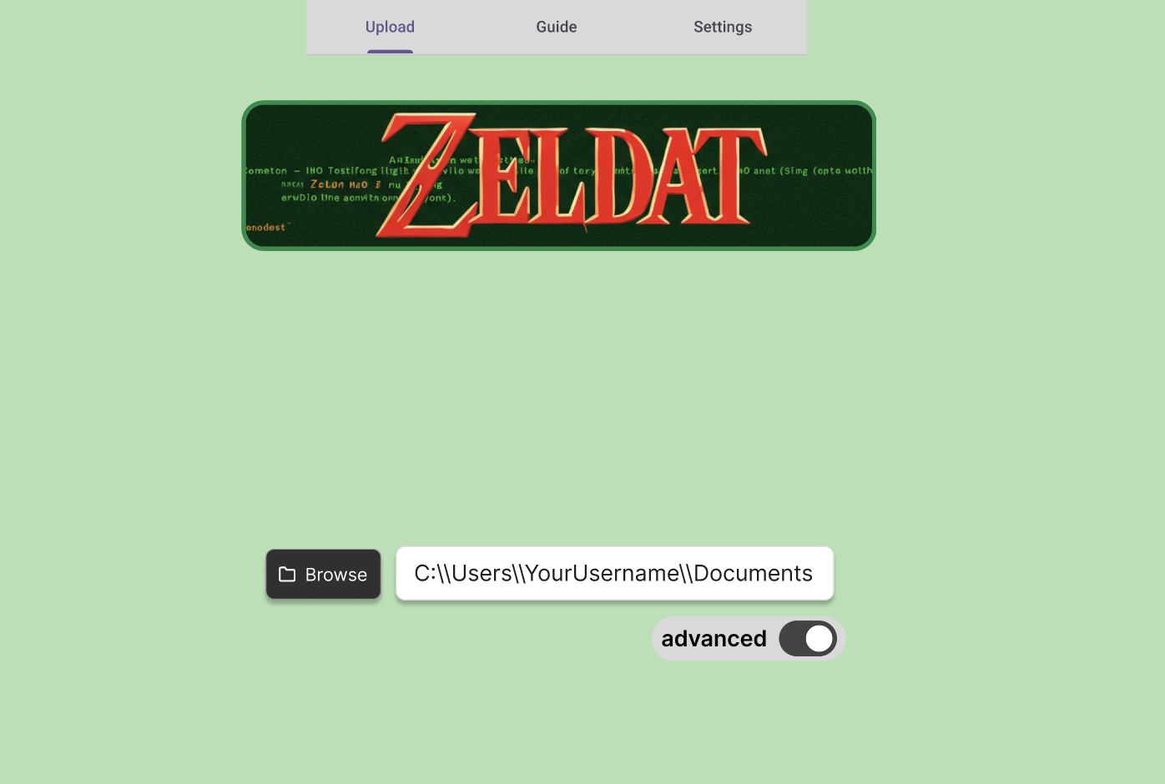
Screenshots (UI, Code, if any)

Slide 12
What Next??
Get Django running and start working on htmx UI
Work on integration into backend
Finish analyzing file structures and building data manipulation algorithms

